Slide 1

Kobe Bryant
Diraksa Munajat Onur Tepençelik
Haonan Peng Guanqing Li

Slide 2
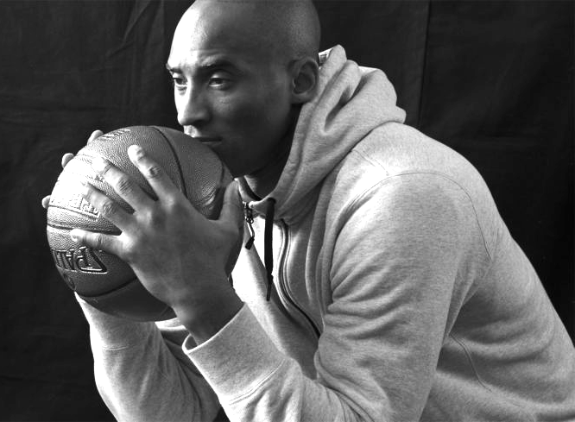
Motivation
Kobe’s impact
Shot distribution
Evolution of Kobe’s shots/skills
Favorite shot location/s
Tied game, should you pass it to Kobe?
Notes:
What kind of impact does Kobe’s statistics have on their team’s chance of winning?
How are Kobe’s shot attempts distributed in terms of the style of the shot?
When does Kobe attempt shots during a game?
How has Kobe’s shot progressed/changed throughout his years in the League?
What are Kobe’s favorite locations to attempt a shot? How did his location preferences change progressively?
How has his skills evolved during his time in the NBA?

Slide 3
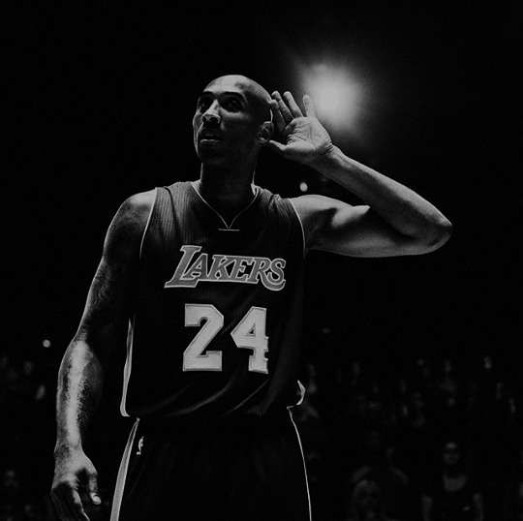

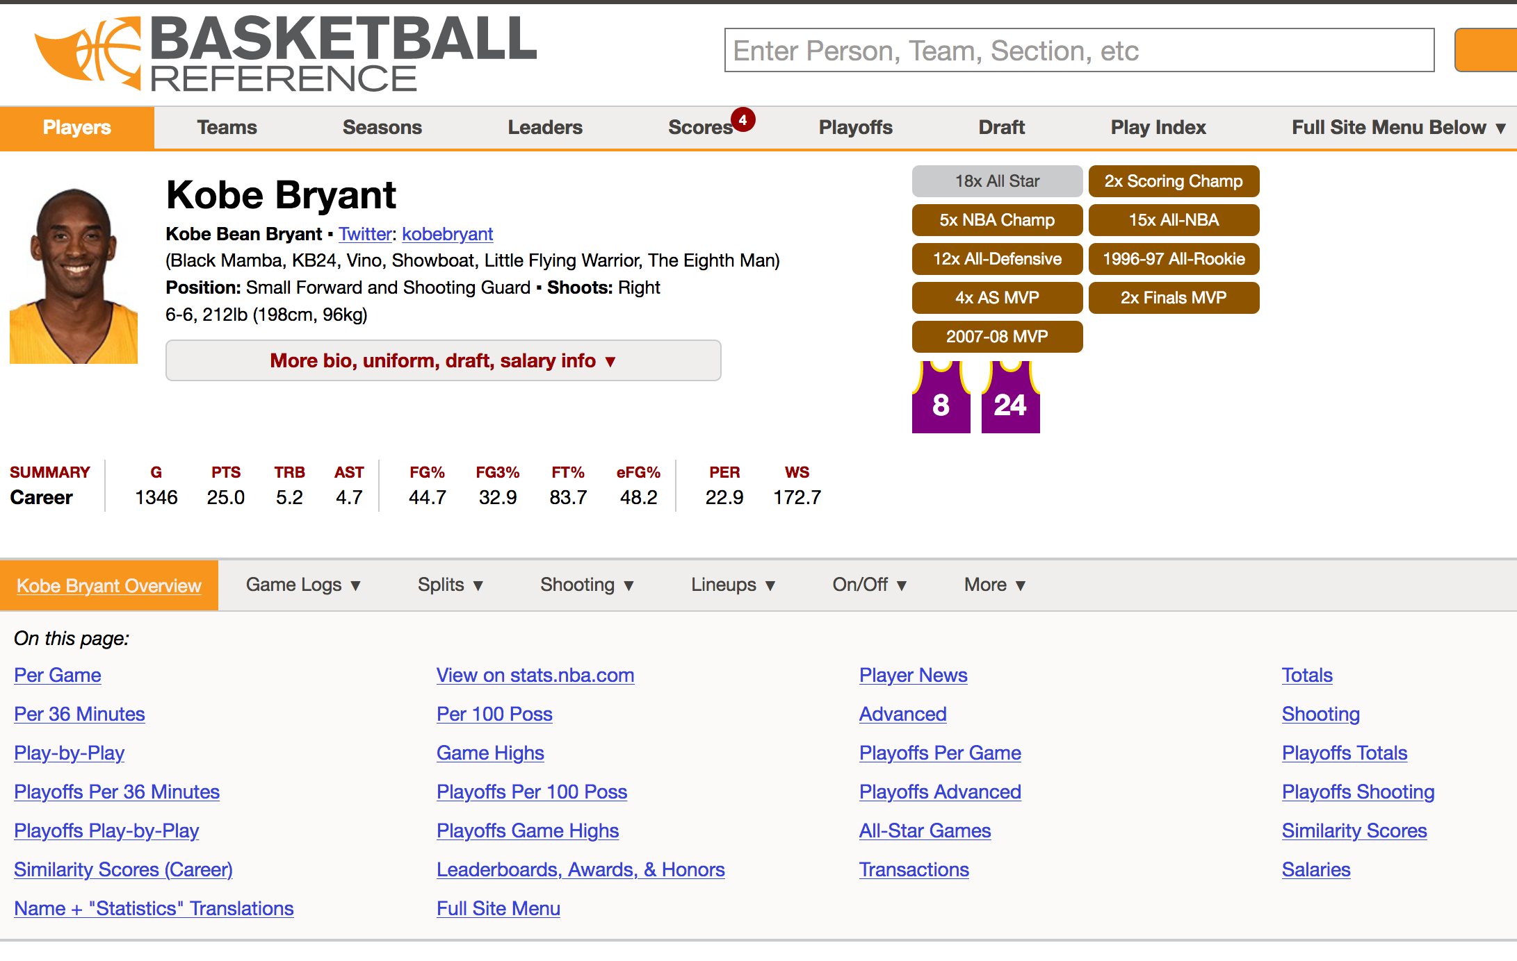
Dataset
Shot selection data
Location
Distance
Shot type
Game clock
Career Statistics
All kinds of essential statistics of basketball: points, rebounds, assists etc.
Notes:
Two main datasets are used to seek answers to the research questions.
Kobe Bryant Shot Selection Dataset:
Contains information about each and every shot from Kobe Bryant throughout his career.
Kobe Bryant Career Statistics
An overview of Kobe Bryant’s career on a season per season basis.
The data is downloaded/scraped from the websites into dataframes and analyzed using all the good Python coding practices.

Slide 4
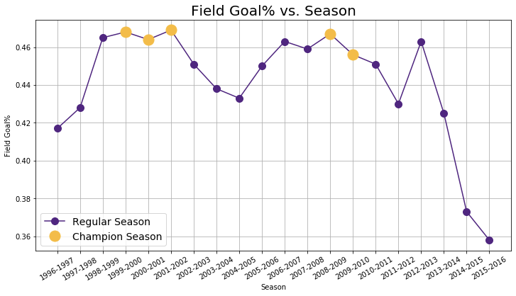
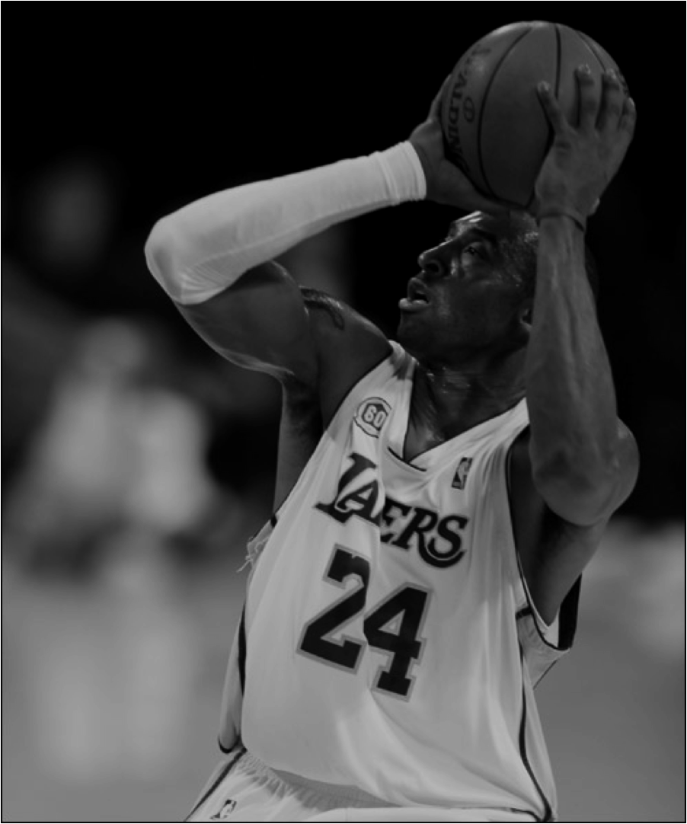
Analysis - Field Goal Accuracy per Season
*A field goal is a shot attempt while the game clock is running.
Notes:
Talk about correlation etc, Why is there a drasitc fall and rise etc

Slide 5
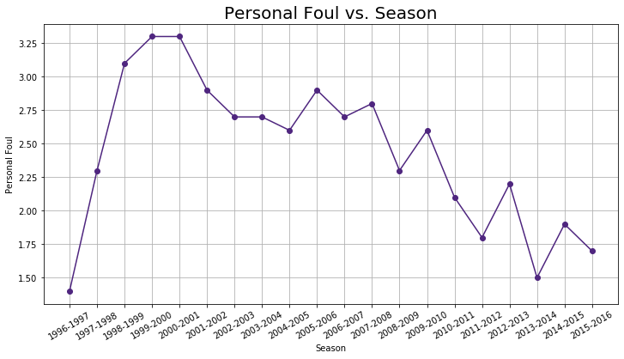
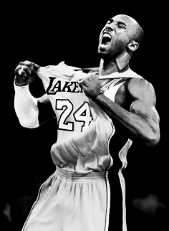
Analysis - Personal Foul per Season
*A personal foul is a breach of the rules that concerns illegal contact with an opponent.
Notes:
Talk about how he became a much more responsible player over the years, when he is defending..

Slide 6
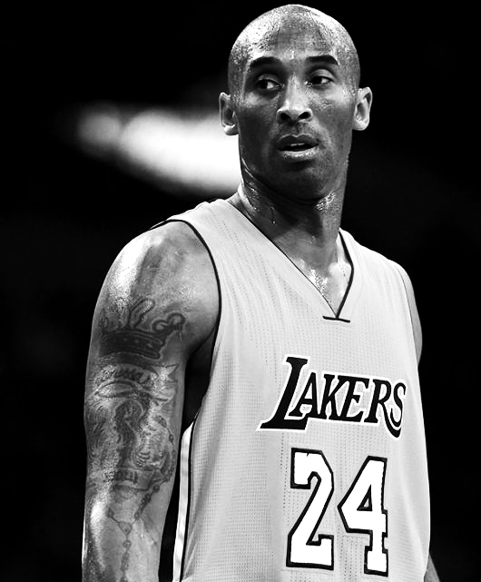
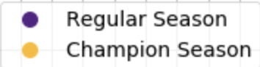
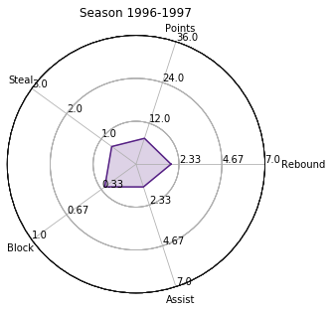
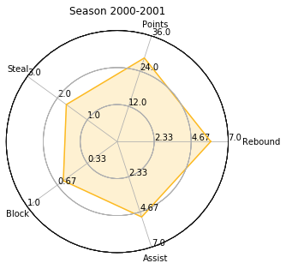
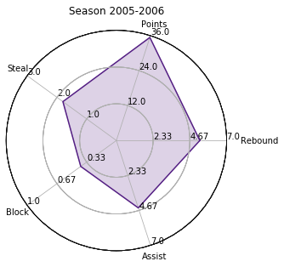
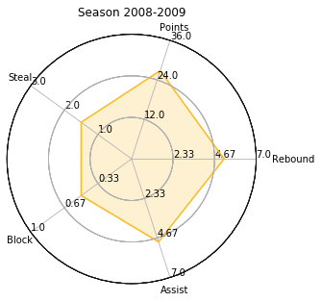
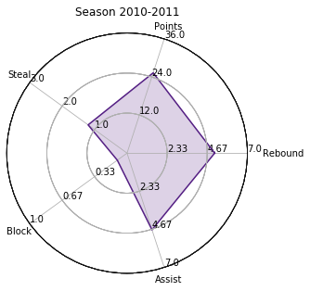
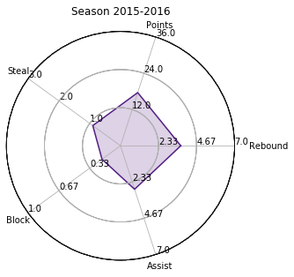
Analysis - Career Statistics per Season
How has his skills(stats) evolved during his time in the NBA?
Rebound: Retrieving the ball after a missed shot attempt.
Assist: Passing the ball to a teammate who then scores.
Steal: Taking the ball away from the opposing team
Block: Deflecting the field goal attempt of an opposing player.
Notes:
Third radar: Points doesn’t necessarily mean championships. On the radars with the higher assists, he is more likely to win a championship

Slide 7
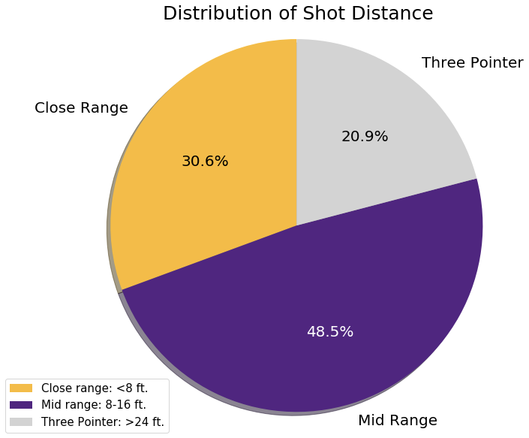
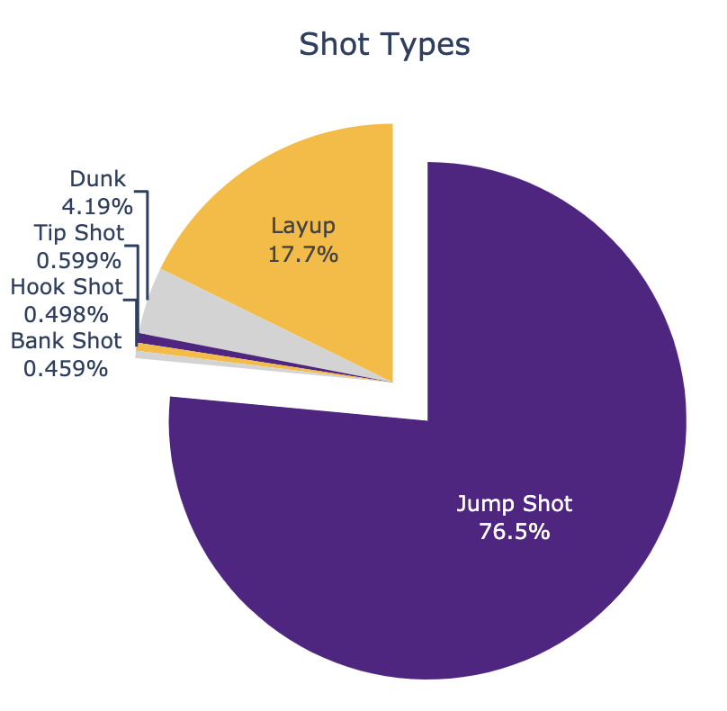
Analysis - Shot Styles
Favorite Type of Shot
Notes:
Traditionally, Kobe is known for his mid range jump shot, proven by the data.

Slide 8
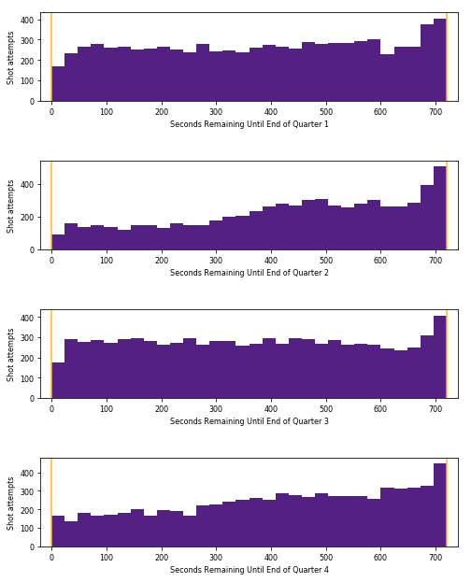
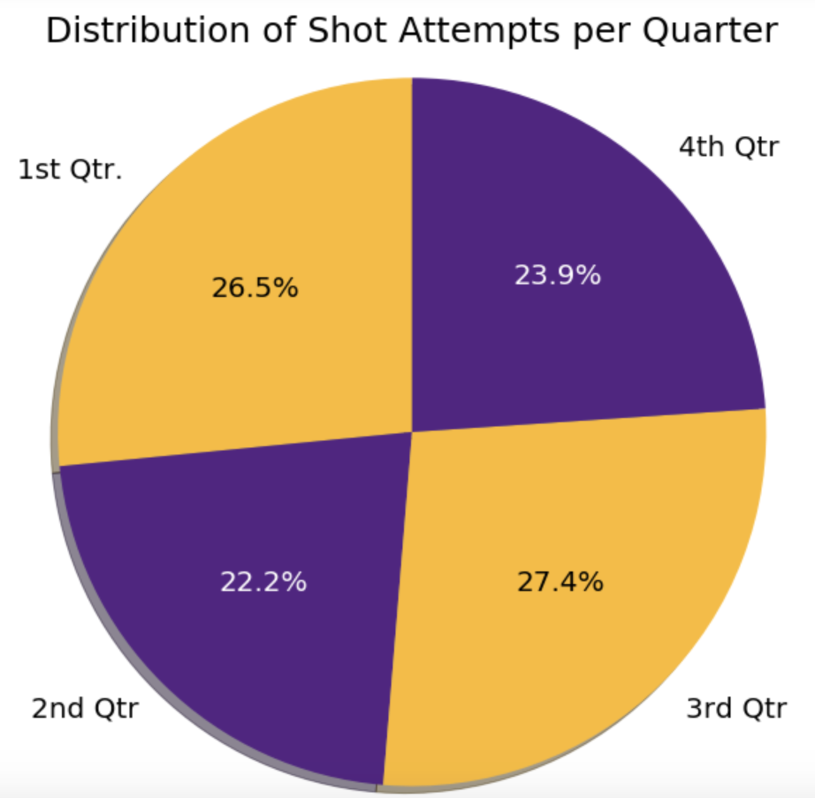
Analysis - Shot Timings
Notes:
Talk about timing. Kobe is benched in the start of second and fourth quarters to rest and save energy for critical parts of the game.
Kobe is highly encouraged to take last second shots, regardless of the quarter. Always go for the style points :P

Slide 9
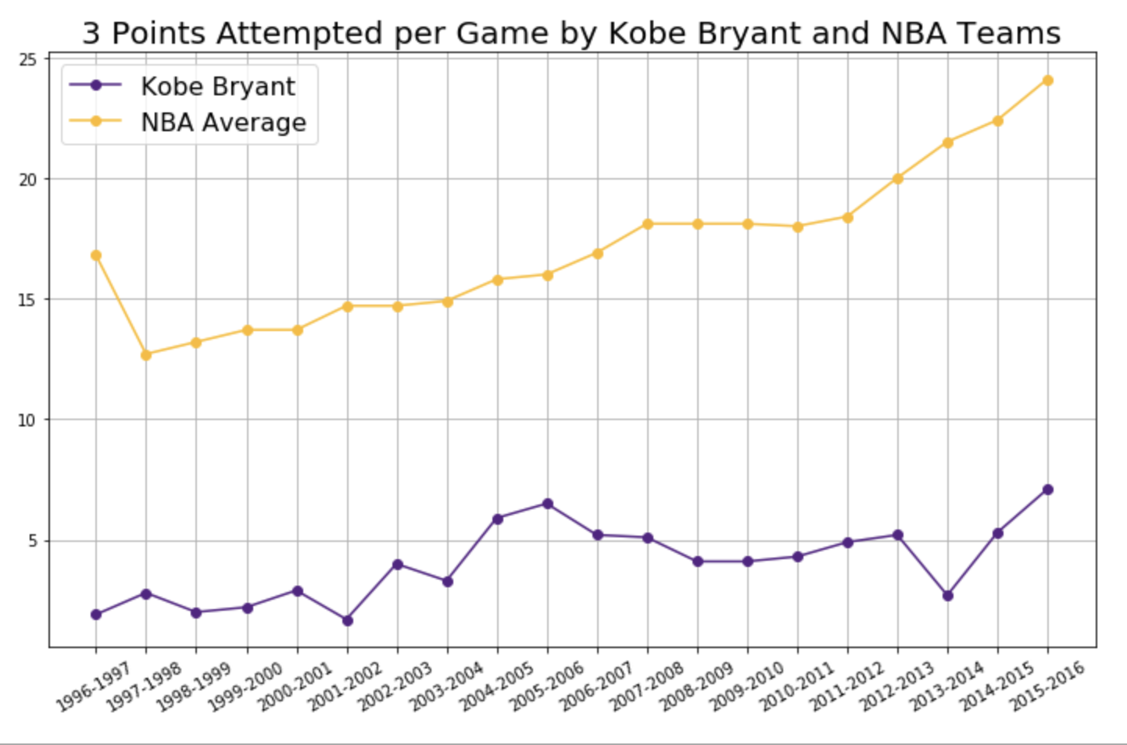
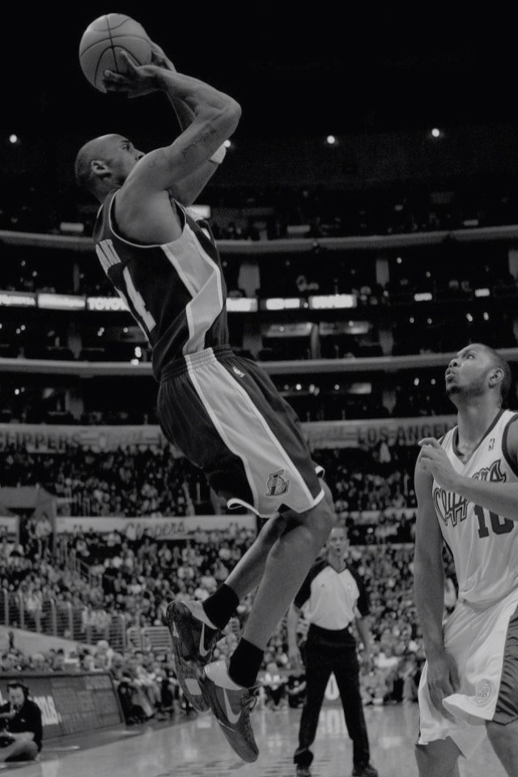
Analysis - Three Point Attempts per Season
*A three pointer is a shot attempt behind the 3 point line (~24 feet distance)
Notes:
We need Jenny to plot this on Jupyter, I have the code on drive.

Slide 10
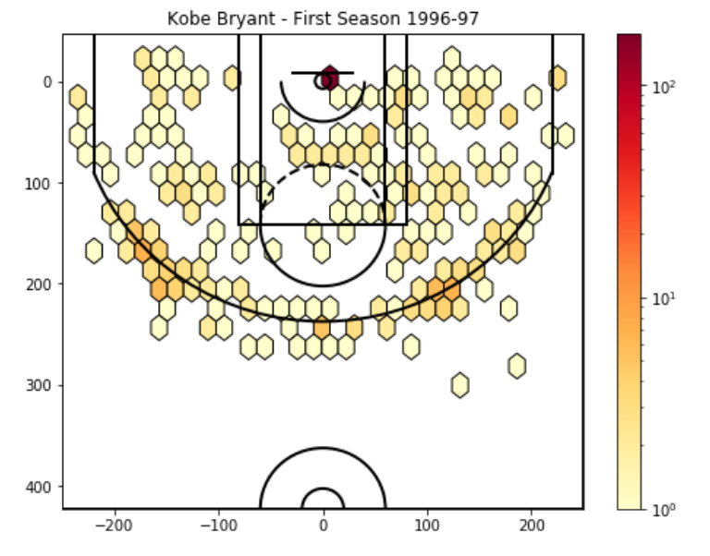
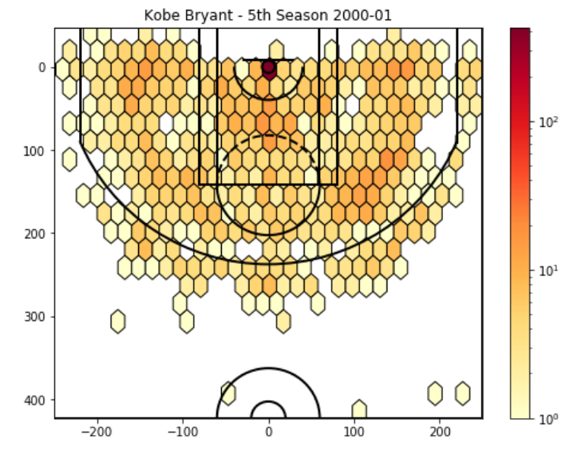
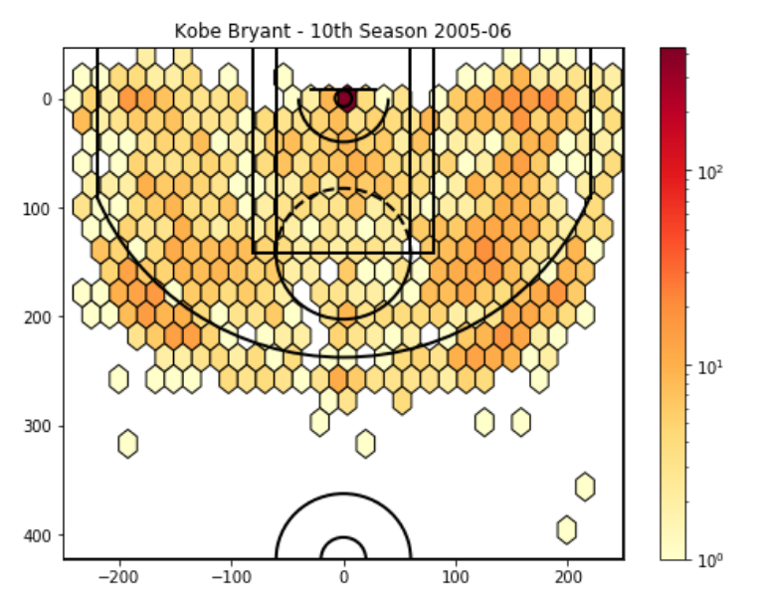
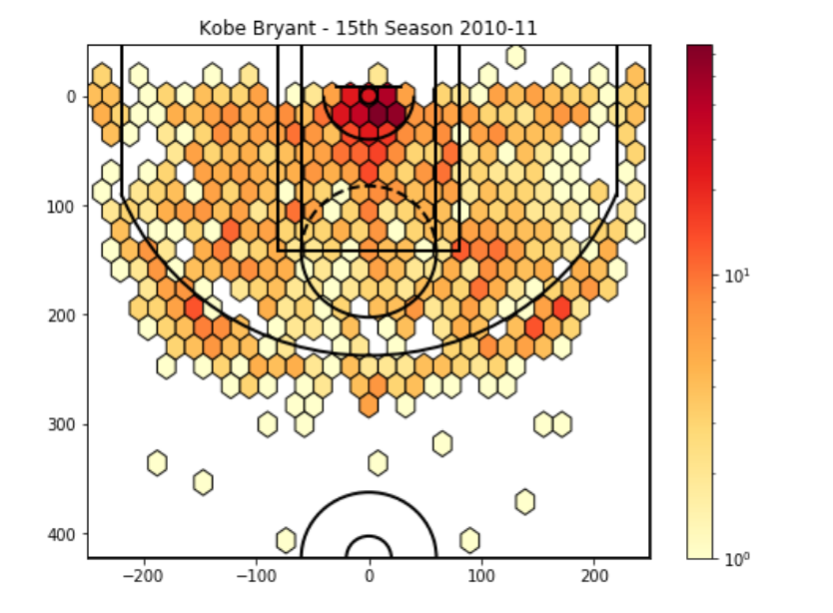
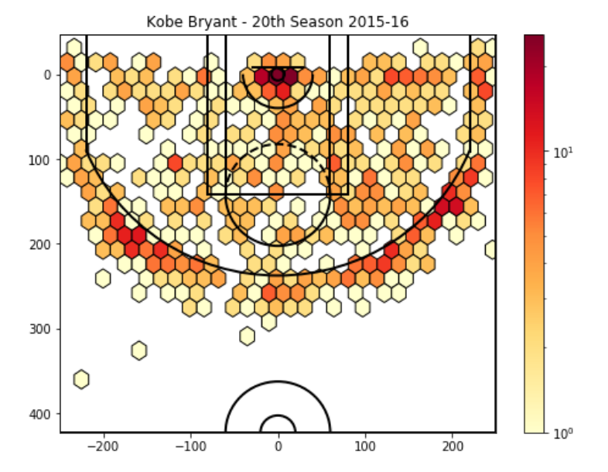
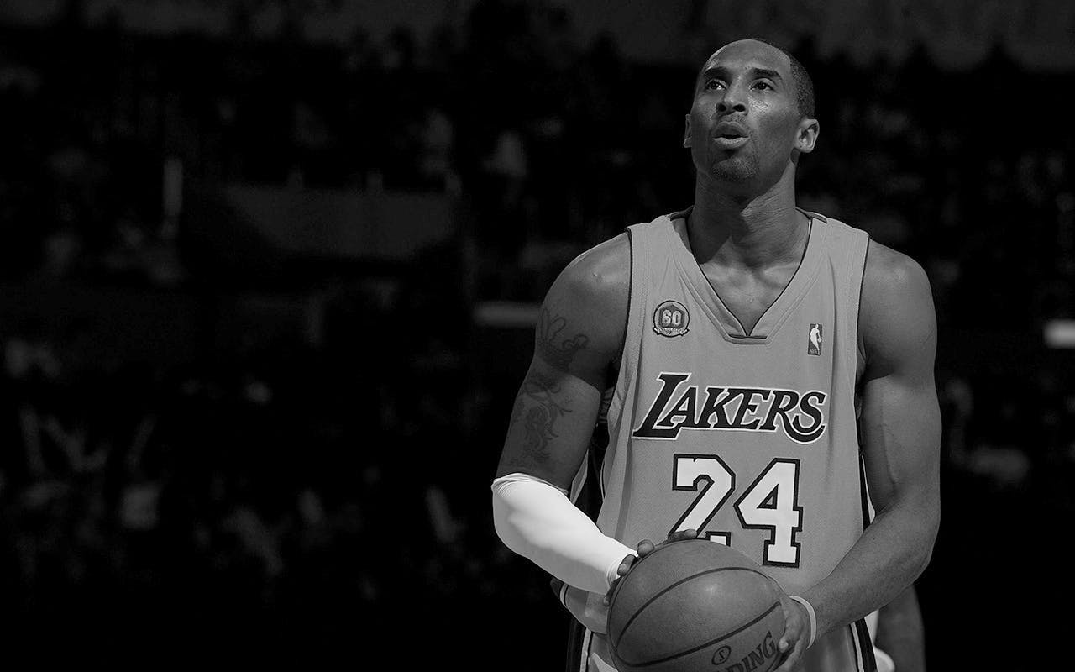
Analysis - Shot Selection
How does Kobe Bryant’s shot selection evolve as he gains more experience( Wiser with age? )
Notes:
Note the increase in 3 point attempts.
Early on in Kobe’s Career we already notice some clusters that form which indicates his most preferred area. We really noticed these clusters during his 10th and 15th season.
Kobe has adapted himself to the general strategy evolution of the league: shoot more threes. Another reason is to save his energy since he is older, and prevent injuries by not penetrating towards the basket.

Slide 11
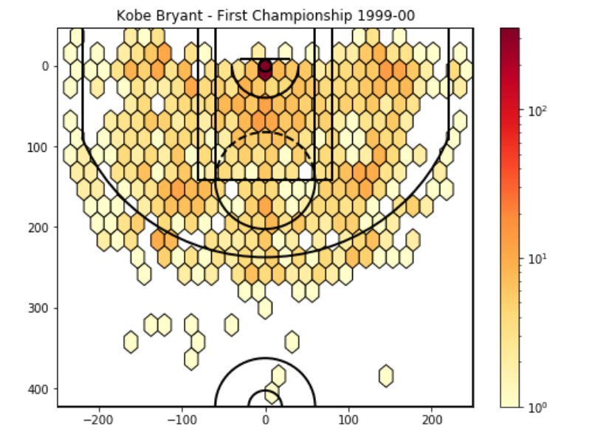
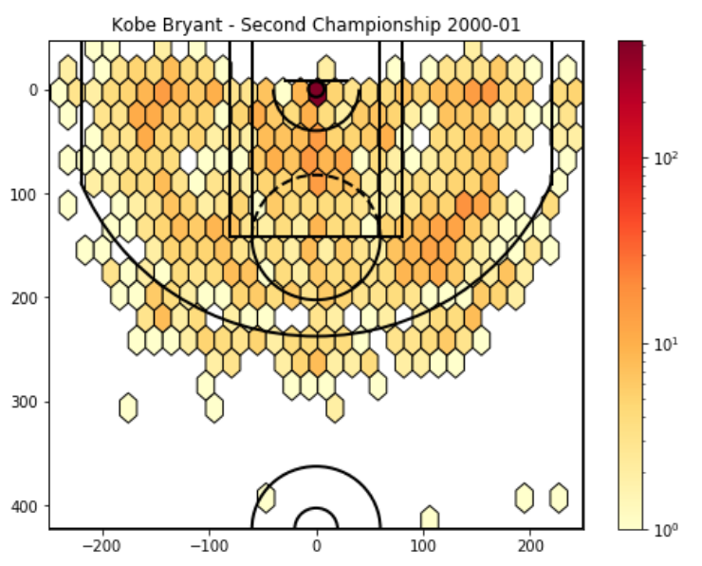
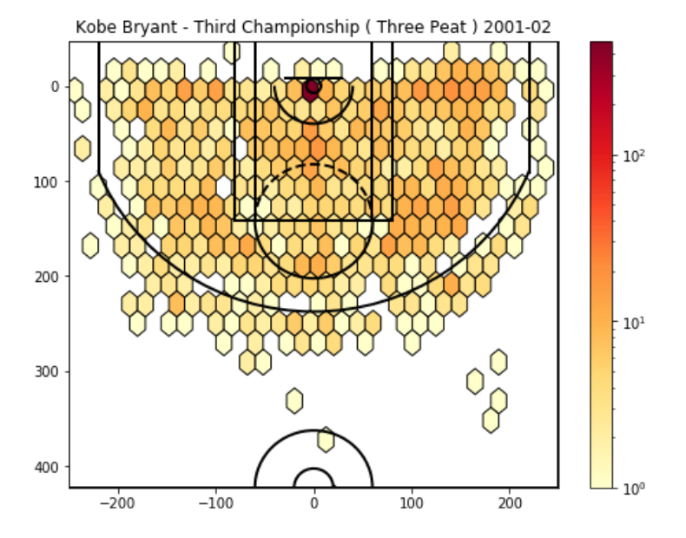
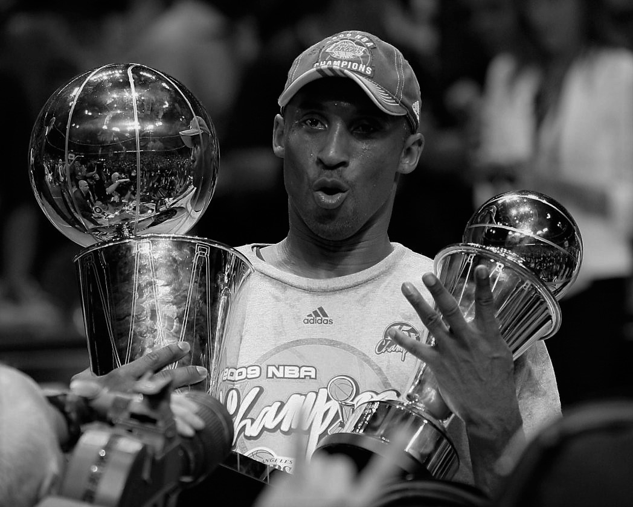
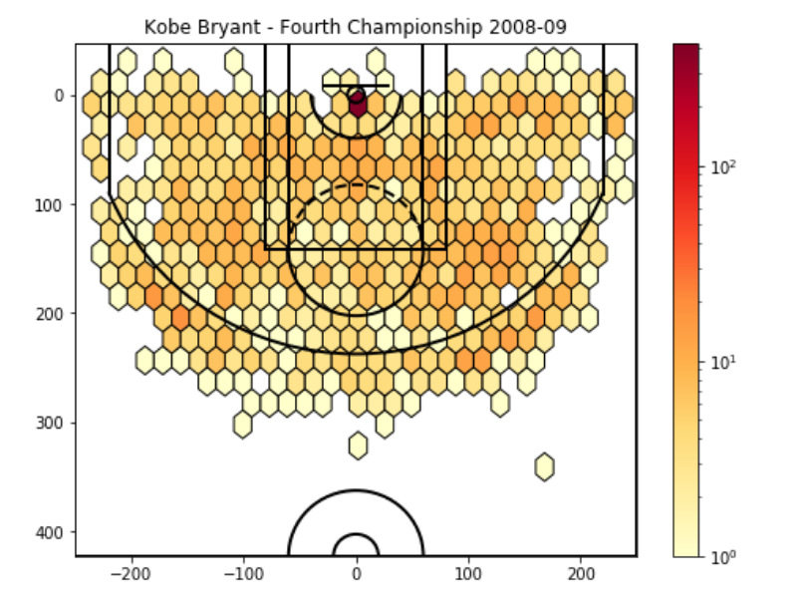
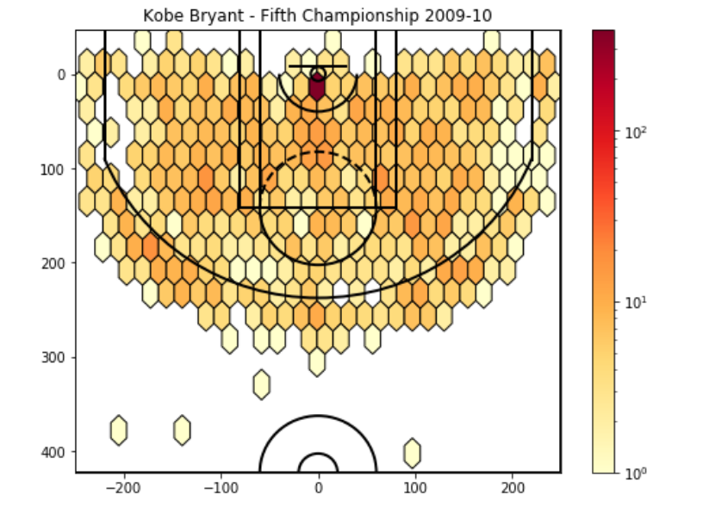
Analysis - Shot Selection
Championship shot selection
Notes:
Again, more three pointers were needed for the last 2 championships, whereas he shot a lot more frequently from the paint in the first three.
Maybe we can add the purple circle remarks, for the paint shots in the first 3 graphs and for the three pointers in the last 2 graphs.

Slide 12
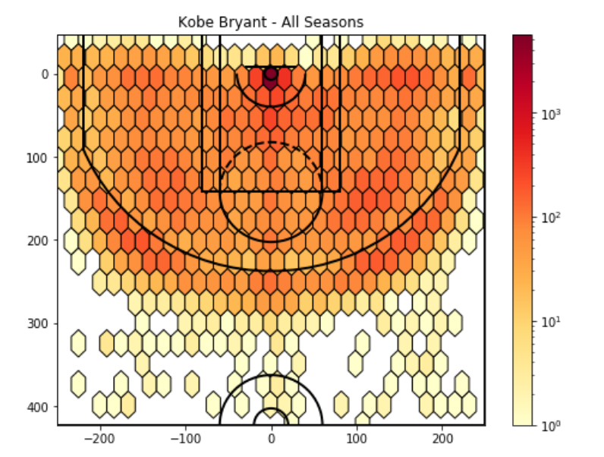
Recap
Kobe’s Shot Selection
Go to Location
Shot Progression
Shot Distribution
Notes:
Kobe is symmetric.

Slide 13
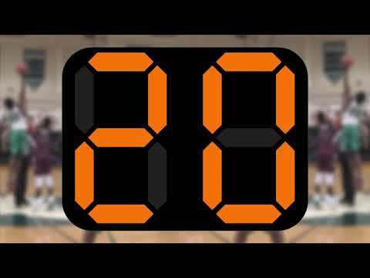
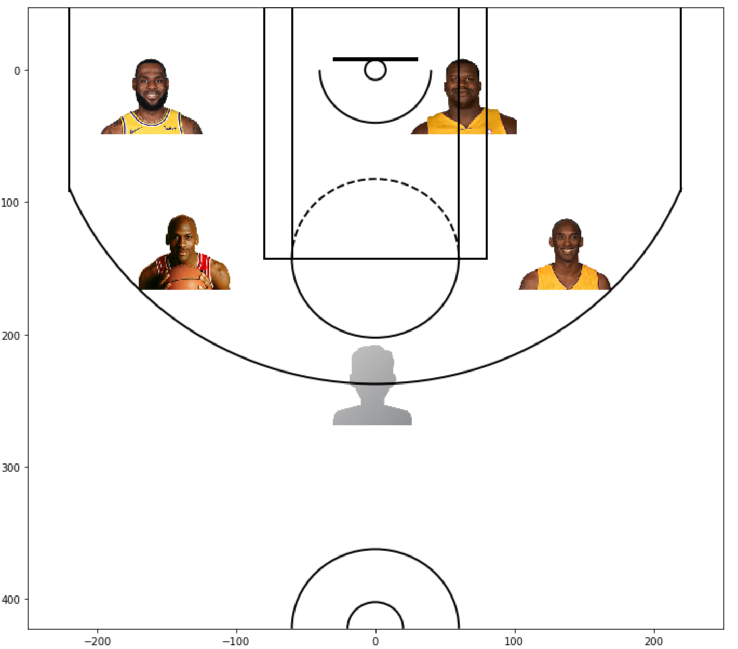
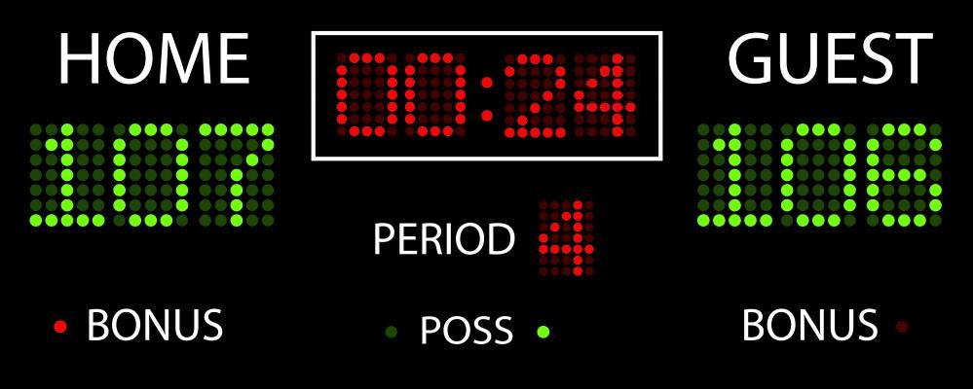

Scenario - Championship Game
LeBron James
Shaquille O'Neal
Michael Jordan
Kobe Bryant
You
Game Winner FG%:
Kobe Bryant: 29.4%
LeBron James: 43.8%
Michael Jordan: 50%
Shaquille O’Neal: Not enough data
Notes:
Championship game. Score is tied
The coach explicitly tells you that you must pass the ball to one of these players.
10 seconds left. What do you do?

Slide 14
Conclusion
Kobe had a great impact on his team’s championships.
Kobe has developed himself to adapt the overall strategies in the league and to be a more responsible player.
Sometimes data is not enough to demonstrate information:
Kobe is a legend who greatly impacted the sports world with his determination and strive to win, and he will always remain in our hearts.
Notes:
Kobe’s Impact:
Shot Distribution: Kobe favored his jump shots, especially his mid range jumpers and fadeaways

Slide 15
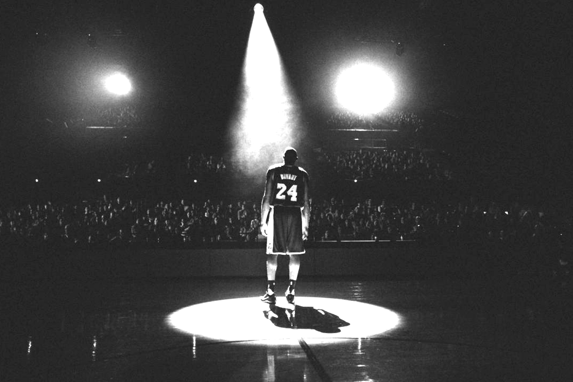
Thank You

